Slide 1
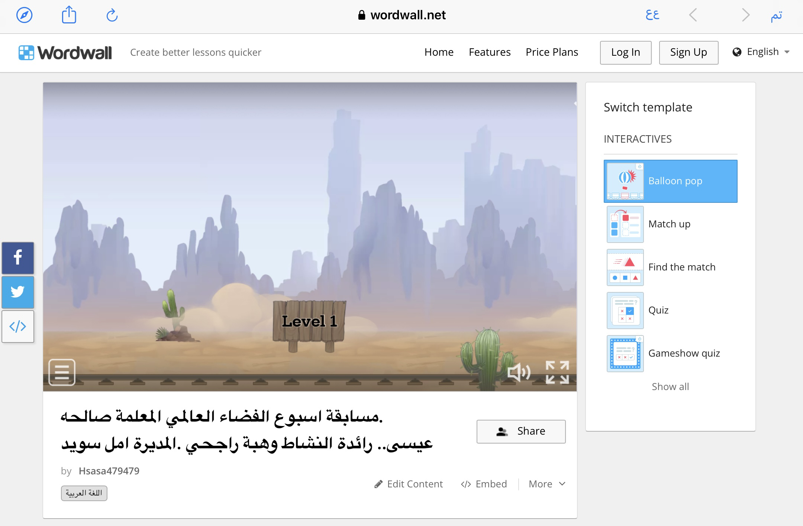
https://wordwall.net/resource/39462902

